Slide 1
Neural Network

Slide 2
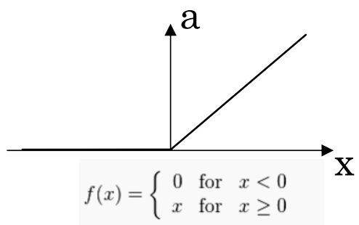
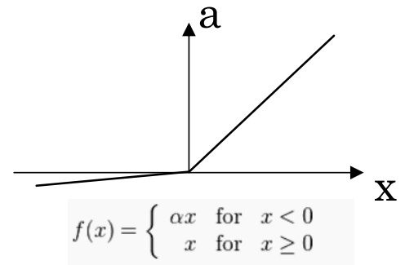
Activation Function
Rectified Linear Unit(ReLU)
Leaky ReLU

Slide 3
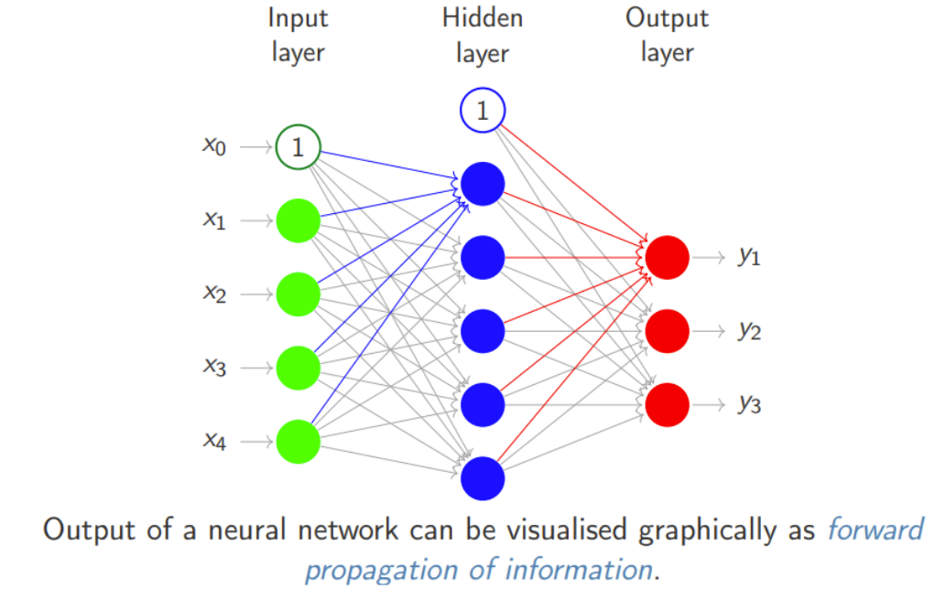
Neural Network

Slide 4
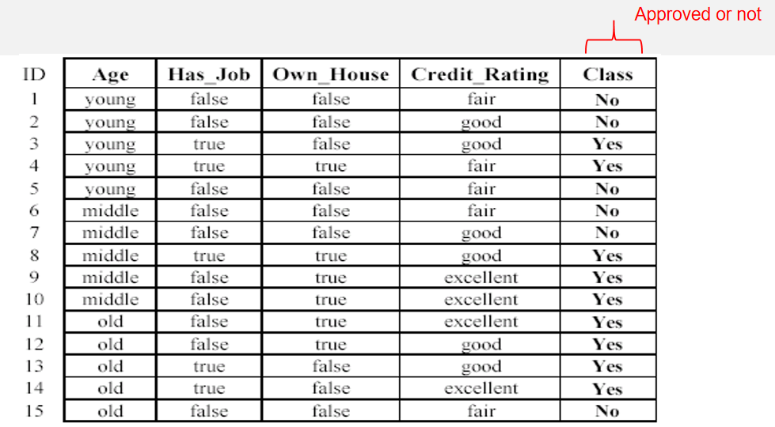
An example: data (loan application)

Slide 5
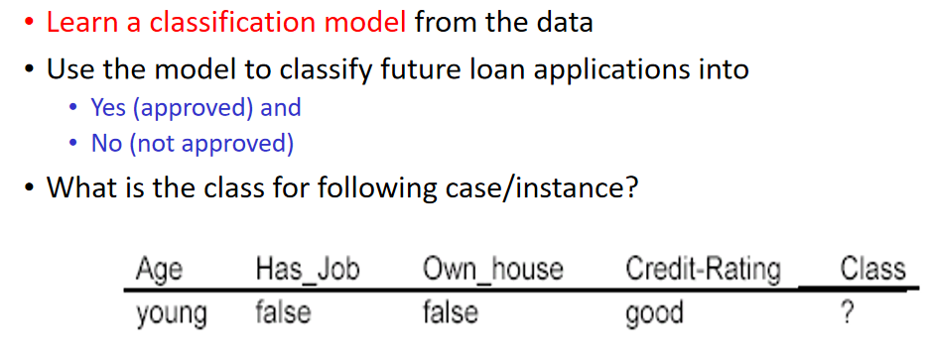
An example: the learning task

Slide 6
Example
Number of input neurons (Input Layer)=2
Number of hidden neurons (Hidden Layer)=3
Number of output neurons (output Layer)=1
Activation function for both hidden and output layer is sigmoid

Slide 7
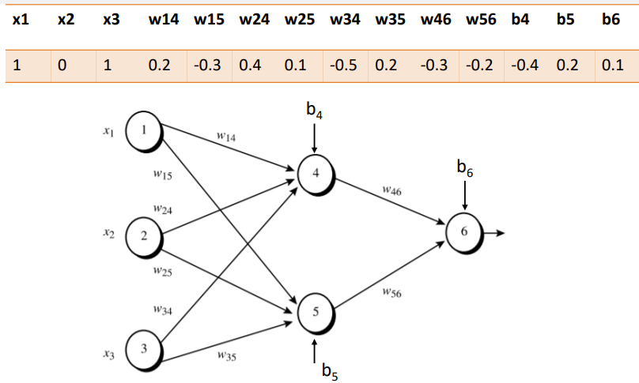
Example

Slide 8
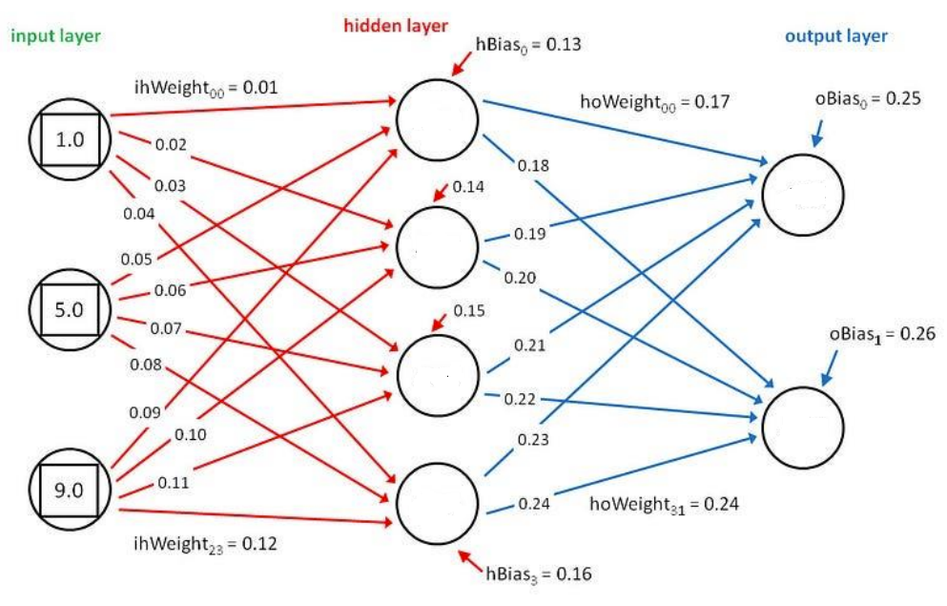
Example

Slide 9
One HOT Encoding

